Slide 1
Class 1
Introduction to
Trade and Trade Policy
PubPol 201
Module 3: International Trade Policy

Slide 2
Class 1 Outline
Introduction to Trade and Trade Policy
Growth of world and US trade
The World Trade Organization (WTO)
Regional trade agreements
US trade policies and institutions
Recent events

Slide 3
Class 1 Outline
Overview of Trade and Trade Policy
Growth of world and US trade
The World Trade Organization (WTO)
Regional trade agreements
US trade policies and institutions

Slide 4
Growth of world and US trade
The world economy, GDP, has grown dramatically over time
World trade has grown even faster

Slide 5
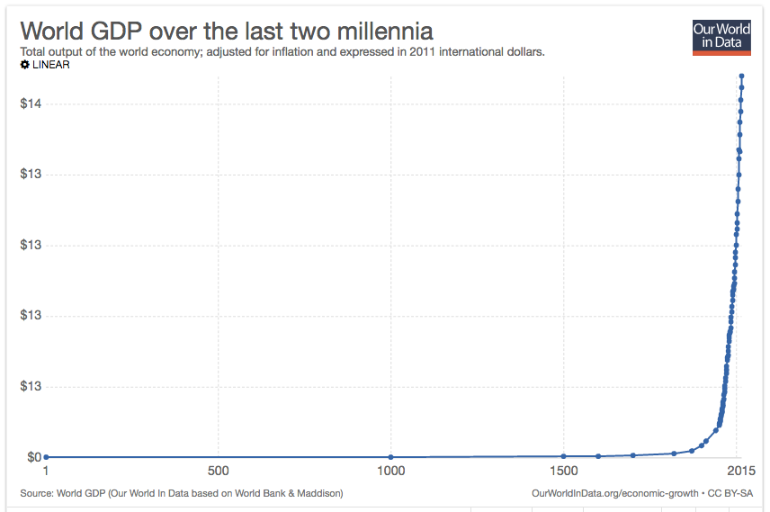
Notes:
https://ourworldindata.org/economic-growth

Slide 6
?

Slide 7
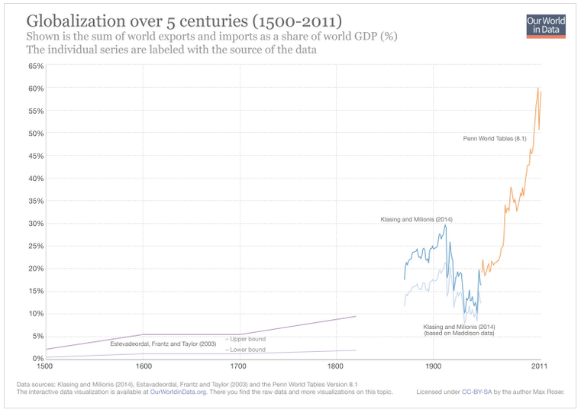
SecondGlobalization
First Globalization
Notes:
https://ourworldindata.org/international-trade

Slide 8
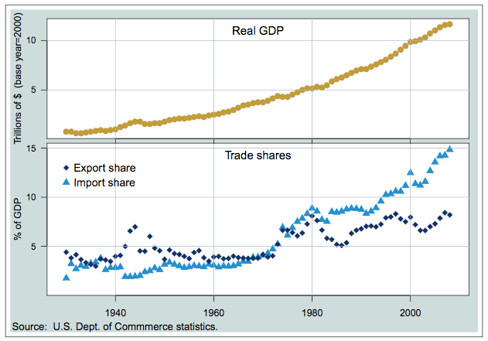
US GDP & Trade
Trade Deficit
Notes:
From USITC, US Trade Policy since 1934,

Slide 9
Discussion Question
Why has trade grown so fast?
  The next two slides will show just two reasons
  Your ideas?

Slide 10
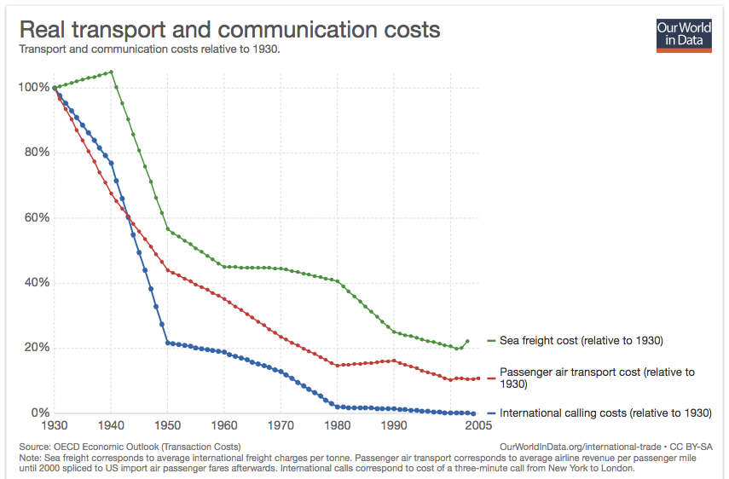
Notes:
https://ourworldindata.org/international-trade

Slide 11
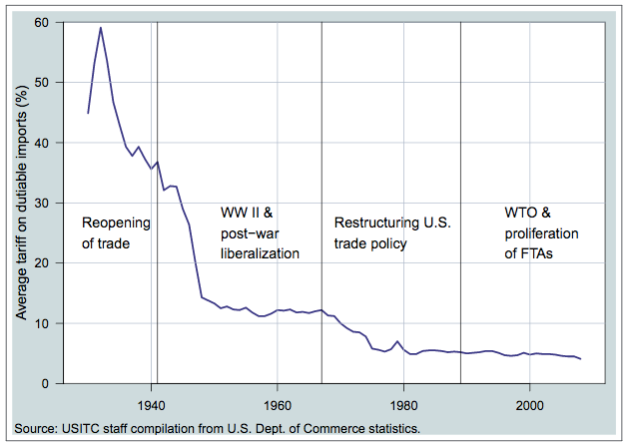
US Tariffs
Notes:
From USITC, US Trade Policy since 1934,

Slide 12
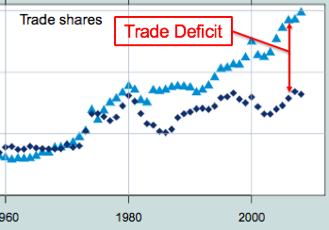
Clicker Question
When did the US start running trade deficits?
  1940
  1960
  1980
  2000
  2010
✓

Slide 13
Class 1 Outline
Overview of Trade and Trade Policy
Growth of world and US trade
The World Trade Organization (WTO)
Regional trade agreements
US trade policies and institutions

Slide 14

World Trade Organization
WTO (and before it, the GATT)
  Rounds of multilateral tariff reductions
  Discipline on nontariff barriers
  Expanded coverage to include
    Services
    Intellectual Property
  Members
    GATT 1947: 23
    WTO now: 164

Slide 15
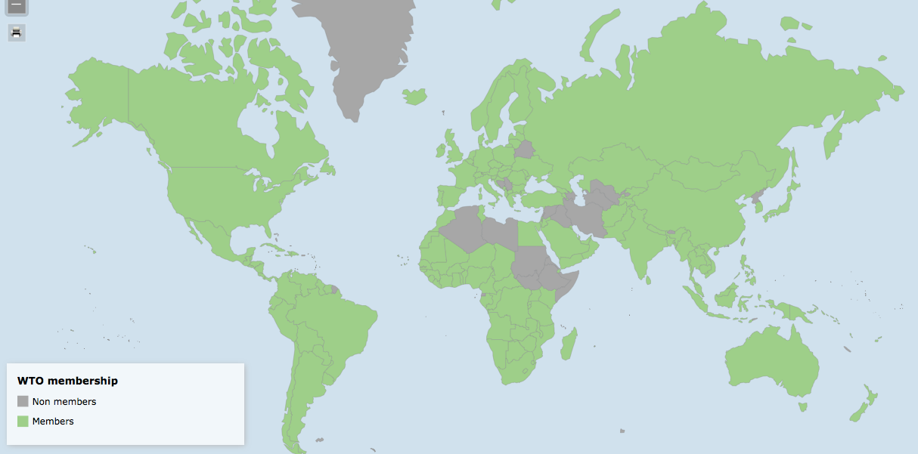
World Trade Organization
Interactive: https://www.wto.org/english/res_e/statis_e/statis_maps_e.htm

Slide 16
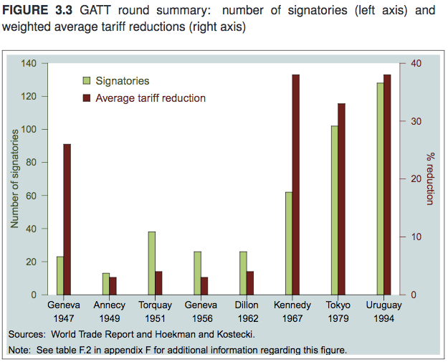

Slide 17
World Trade Organization
International Rule of Law
  GATT/WTO agreed rules for uses of trade policies
    Must not raise tariffs above levels that countries commit to
    Must not use certain other trade barriers
    Enforced through permitted retaliation

Slide 18
World Trade Organization
Rules do permit “trade remedies,” but constrain their use
  Safeguards tariffs
    Against imports causing injury
  Anti-dumping duties
    Against imports “unfairly priced”
  Countervailing duties
    Against subsidized imports
  (More on these below)

Slide 19
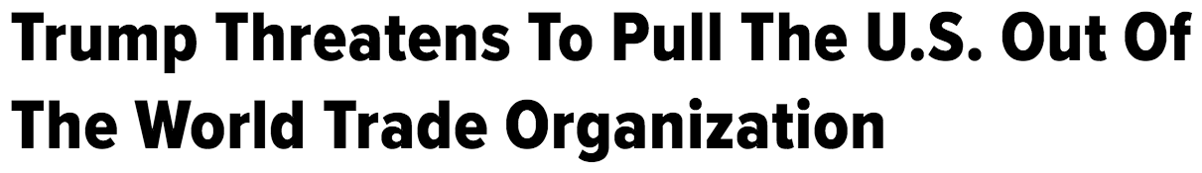

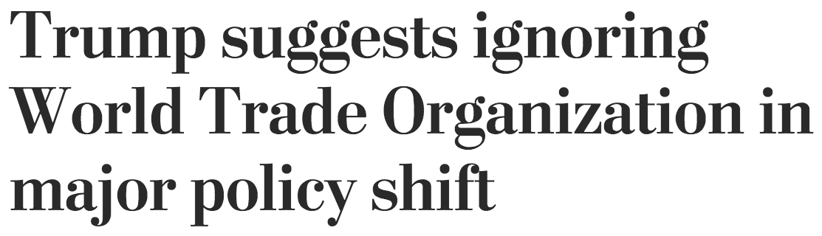

World Trade Organization
Donald Trump
  Has been critical of WTO
  Wants to ignore WTO
Jul 24, 2016
Mar 1, 2017

Slide 20
Clicker Question
What does MFN stand for?
  Multilateral Funding Network
  Most Favored Nation
  Maximum Financial Need
  Minimum Fiduciary Nexus
✓

Slide 21
Clicker Question
Which is not one of the main components of the WTO?
  Requirement that import tariffs be reduced
  Negotiating forum
  Rules
  System for settling disputes
✓

Slide 22
Clicker Question
What did the Uruguay Round, which created the WTO, add that was particularly beneficial for the United States?
  Reduced tariffs on agricultural products
  Enforcement of labor standards
  Expanded coverage for trade in services
  Permission to block imports from China
  The Generalized System of Preferences
✓

Slide 23
Discussion Question
What are your views, and what have you heard, pro and con, about the WTO?

Slide 24
Class 1 Outline
Overview of Trade and Trade Policy
Growth of world and US trade
The World Trade Organization (WTO)
Regional trade agreements
US trade policies and institutions

Slide 25
Regional trade agreements
Pairs or groups of countries that
  Eliminate most tariffs on imports from members
  Tariffs on outsiders?
    Leave unchanged and different
      FTA = Free Trade Area
      Example: NAFTA
    Adopt common external tariffs
      CU = Customs Union
      Example: European Union

Slide 26
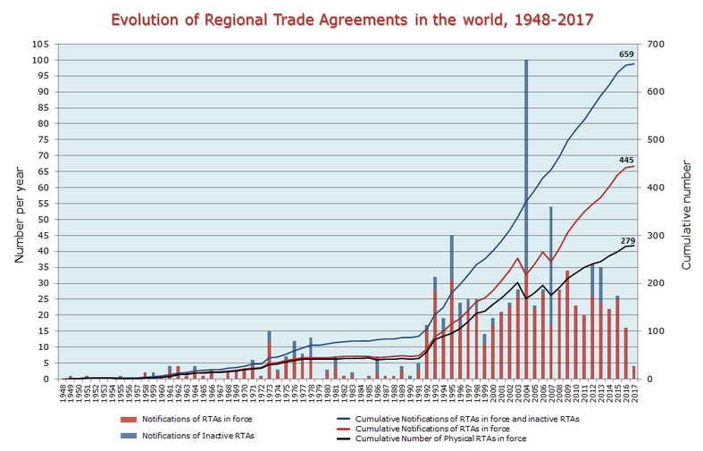
Notes:
https://www.wto.org/english/tratop_e/region_e/regfac_e.htm

Slide 27
US FTAs
Date | Agreement | Date | Agreement
1985 | US-Israel | 2006 | CAFTA-DR (US-Dominican Rep-Central America)
1989 | US-Canada | 2006 | US-Bahrain
1994 | NAFTA (US-Canada-Mexico) | 2009 | US-Peru
2001 | US-Jordan | 2009 | US-Oman
2004 | US-Singapore | 2012 | US-Colombia
2005 | US-Chile | 2012 | US-Panama
2005 | US-Australia | 2012 | US-South Korea
2006 | US-Morocco
Notes:
USTR

Slide 28
US FTAs
Donald Trump
  Pulled US out of TPP = Trans-Pacific Partnership
    FTA among US, Canada, Mexico, Japan, and 8 others (not including China)
  Threatened to pull out of NAFTA
    Has just renegotiated it
  US-Korea FTA
    Amended it, but in a way that reduces trade
Notes:
USTR

Slide 29
Discussion Question
What have you heard about NAFTA and other US FTAs?
We’ll be studying NAFTA during our last week of this module.
Notes:
USTR

Slide 30
Class 1 Outline
Overview of Trade and Trade Policy
Growth of world and US trade
The World Trade Organization (WTO)
Regional trade agreements
US trade policies and institutions

Slide 31
US Trade Policy
Who Is Responsible?
  Department of International Trade?
    No, we don’t have one
  US Constitution gives power to set import tariffs to Congress
    Congress has sometimes delegated that to the President
    See “Fast Track” below

Slide 32
US Trade Institutions
Responsibility for trade issues is spread over many entities
  Congress
  USTR = US Trade Representative
  Commerce Department
  US International Trade Commission
  Export-Import Bank
  and several others

Slide 33
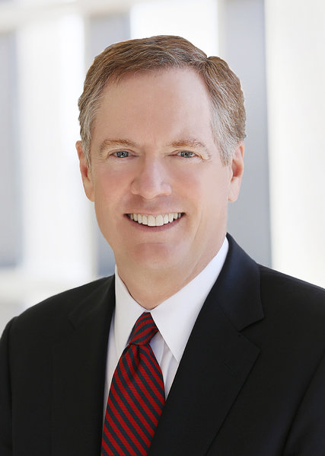
US Trade Institutions
Trump’s USTR is Robert Lighthizer
Cabinet-level official of US government
Role
  Handles negotiations on trade issues
  Drafts trade legislation for Congress

Slide 34
US Trade Institutions
Congress
  Sets tariffs and other trade policies (thus approves trade agreements)
  Two committees are responsible
    House: Ways and Means
    Senate: Finance
  Why these?
    Because trade policy was originally about collecting revenue

Slide 35
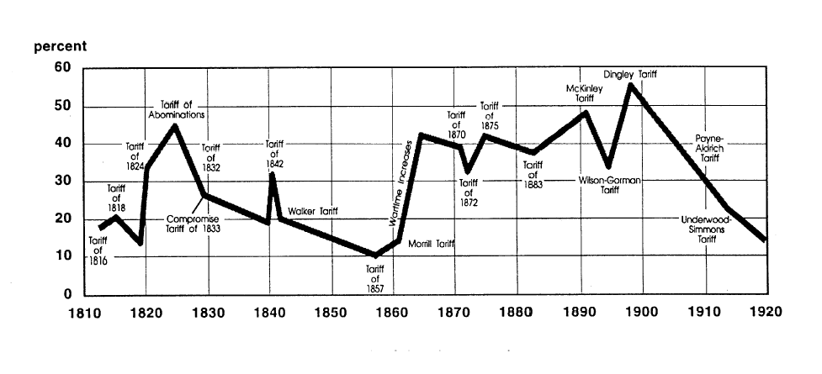
US tariff history: 1810-1920
Today
Notes:
Source: landandfreedom.org

Slide 36
US Trade Remedies
Escape Clause = Section 201 (Called “Safeguards” in WTO)
  Temporary protection from injurious imports
    Does NOT allege that the imports are “unfair”
  Eligibility is decided by USITC alone
    Injury (must be serious)
    Causation (must be due to imports)
  Tariff must be non-discriminatory
  Implemented by President, who may say NO.

Slide 37
US Trade Remedies
Unfair Trade Laws
  Permit protection (not temporary) from “unfair” imports
    Must also be injurious, but less than escape clause
    “Unfair” if
      “Dumped”, i.e., priced too low by firm
      Subsidized by foreign government
    Results:
      Anti-dumping duties (AD)
      Countervailing duties (CVD)
  President cannot say no

Slide 38
US Trade Remedies
Section 301
  Permits tariffs against countries that use “unfair trade practices”
  Vague. & illegal in GATT/WTO unless done through the WTO dispute settlement process
  Usage:
    Used in 1980’s against Japan
    Had not been used since WTO began in 1995
    Now being used by Trump against China for intellectual property theft

Slide 39
Other US Trade-Related Policies
Trade Adjustment Assistance
  Provides help to workers and firms displaced by trade (since 1962)
  Not very large or effective
“Fast Track” (=Trade Promotion Authority)
  Authorizes President to negotiate trade
  Congress commits to vote yes or no, but not change
    Will be used to vote on new NAFTA

Slide 40
Other US Trade-Related Policies
GSP = Generalized System of Preferences
  Lower tariffs for imports from least developed countries
  Permitted by GATT/WTO, and used by most developed countries

Slide 41
US Trade Policies
What motivates US trade policies? (See Baldwin)
  Political parties, but they changed:
  Presidents of both parties (until Trump) favored lower tariffs
    For foreign policy reasons (Cold War)
 | Democrats | Republicans
1930s | Lower tariffs | Protection
Today | Protection | Lower tariffs

Slide 42
Clicker Question
Which of the following is not a part of the US government that deals with trade?
  Congress
  United States Trade Representative
  Commerce Department
  International Trade Commission
  Department of International Trade
✓

Slide 43
Clicker Question
How much of an industry’s domestic production must be produced by a group of US firms in order for it to qualify for requesting an anti-dumping duty?
  10%
  35%
  50%
  75%
  100%
✓
See reading by Verrill

Slide 44
Clicker Question
Which US trade law can a US firm use against a foreign firm that is engaged in anti-competitive conduct?
  201
  301
  The anti-dumping statute
  The countervailing duty statute
✓
Also in reading by Verrill

Slide 45
Clicker Question
Of past six US Presidents Reagan, Bush I, Clinton, Bush II, Obama, and Trump, how many have tended to favor trade liberalization?
  1
  2
  3
  4
  5
See reading by Baldwin. Trump is the first in years to favor protection.
✓

Slide 46
Discussion Question
Do you view the United States as mainly a free trader, mainly protectionist, or somewhere in between?

